Slide 1
Introduction to Angular 2
Lesson 02
Notes:
Add instructor notes here.

Slide 2
Lesson Objectives
Introduction of Angular2
What is nodejs
Building blocks of Angular2
What is module-Root Module
First Application with Angular2
Notes:
Add instructor notes here.

Slide 3
What is Angular 2?
Angular2 is a framework for building client applications in HTML and either JavaScript or a language like TypeScript that compiles to JavaScript.
Angular is a TypeScript-based open-source front-end web application platform led by the Angular Team at Google and by a community of individuals and corporations
Angular 2 required to build a frontend web or mobile apps, from powerful templates to fast rendering, data management, HTTP services, form handling, and so much more.
Notes:
Angular is a framework for building client applications in HTML and either JavaScript or a language like TypeScript that compiles to JavaScript.
The framework consists of several libraries, some of them core and some optional.

Slide 4
Why is Angular 2?
Simple
Web Components Oriented architecture
Better Foundation
Mobile first
Speed & Performance
Productivity
Component based programming
Syntax are similar to JAVA
Notes:
We can write Angular applications by composing HTML templates with Angularized markup, writing component classes to manage those templates, adding application logic in services, and boxing components and services in modules.
Angular makes HTML more expressive, It powers up HTML with features such as if conditions, for loops and local variables.
Angular has powerful data binding. We can easily display fields from our data model, track changes and process updates from the user.
Angular promotes modularity by design so that the applications become a set of building blocks making it easier to create and reuse contents.
Angular has built-in support for communication with a backend service this makes it easy for Web applications to integrate with the backend service to GET and POST data or execute server side business logic.
Angular 2 was built for speed, It has faster initial loads faster change detection and improved rendering times.
Angular 2 is modern it takes advantage of features provided in the latest JavaScript standards such as classes, modules and decorators.
It leverages web component technologies for building reusable user interface widgets.
It supports both modern and legacy browsers like Chrome, Firefox and Internet Explorer back to IE 9.
It has a simplified API. It has fewer built-in directives to learn simple binding and a lower overall concept count.
It enhances productivity to improve day to day workflows

Slide 5
What is node Js?
Node.js is an open source server framework
Node.js uses JavaScript on the server
Node.js can generate dynamic page content
Node.js can create, open, read, write, delete, and close files on the server
Node.js can collect form data
Node.js can add, delete, modify data in your database
It’s a highly scalable system that uses asynchronous, non-blocking I/O model (input/output), rather than threads or separate processes
It is not a framework like jQuery nor a programming language like C# or JAVA . It's a new kind of web server like has a lot in common with other popular web servers, like Microsoft’s Internet Information Services (IIS) or Apache

Slide 6
What is node Js?
Node.js is useful for project structuring, module management, dependency installation etc and you need to to do manually all this stuffs.
NPM - Node Package Manager is mainly used to install all the libraries of any framework or all the dependencies configured in json file of the project and it doesn’t work without nodejs.

Slide 7
Installing and using Angular 2
Install Node
https://nodejs.org/en/
Run commands on command prompt
npm –version ------Check node version
git clone https://github.com/angular/quickstart.git quickstart
cd quickstart
npm install ----- install node modules
npm start ----- Start node server & run your Application
Notes:
If you have internet use git otherwise use basic demo
If you have internet use npm install -g @angular/cli & use ng serve

Slide 8
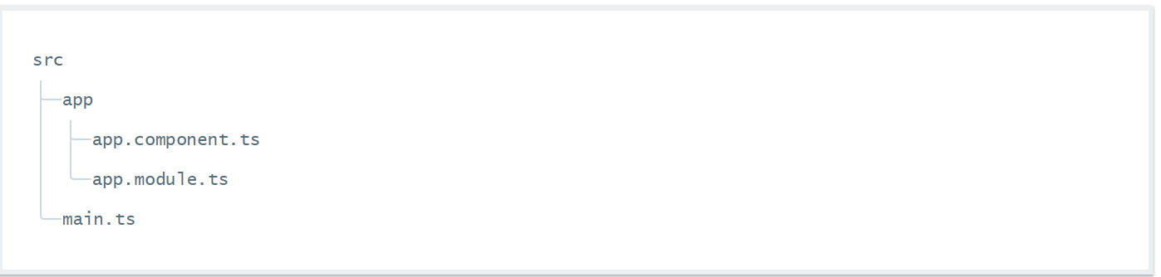
Installing and using Angular 2
Angular 2 Dependencies
core-js
zone.js
Systemjs
systemjs.config.js
After creating Projects 3 typescript file created
Notes:
app/app.component.ts---→
Defines the same AppComponent as the one in the QuickStart playground. It is the root component of what will become a tree of nested components as the application evolves.
app/app.module.ts-→
Defines AppModule, the root module that tells Angular how to assemble the application. Right now it declares only the AppComponent. Soon there will be more components to declare.
main.ts--→
Compiles the application with the JIT compiler and bootstraps the application's main module (AppModule) to run in the browser. The JIT compiler is a reasonable choice during the development of most projects and it's the only viable choice for a sample running in a live-coding environment like Stackblitz. You'll learn about alternative compiling and deployment options later in the documentation.

Slide 9
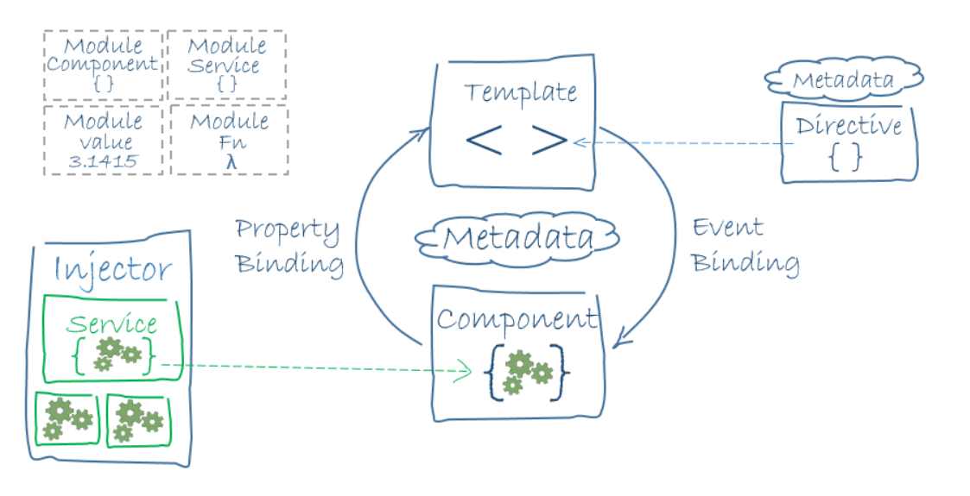
Blocks of Angular 2
The architecture diagram identifies the eight main building blocks of an Angular application-
Modules Components
Templates Metadata
Data binding Directives
Services Dependency injection
Notes:
We can write Angular applications by composing HTML templates with Angularized markup, writing component classes to manage those templates, adding application logic in services, and boxing components and services in modules.
Then we launch the app by bootstrapping the root module. Angular takes over, presenting your application content in a browser and responding to user interactions according to the instructions we have provided.
Then we launch the app by bootstrapping the root module. Angular takes over, presenting our application content in a browser and responding to user interactions according to the instructions you've provided.
Module
Optional feature
Useful if you are using TypeScript which allows you to use interface or classes
export class AppComponent is like saying that this class is going to be public
Use relative file paths for importing modules
Component class is something you’d export from a module.
Component
Components controls Views
Logic to support the view can be inside a class
Angular creates/destroys components as user moves through UI
Template
A form of HTML that describes how to render the Component. It looks mostly like HTML syntax except if you add Angular keywords in them.
Metadata
Some @Component configuration options:
selector: css selector to be applied to that html element
templateUrl: address of the component itself
directives: array of components/directives that this component itself requires to function properly
providers: an array of dependency injection providers for services

Slide 10
Notes:
Data Binding
Following are the four possible ways of data binding:
<div>{{hero.name}}</div> <hero-detail [hero]="selectedHero"></hero-detail> <div (click)="selectHero(hero)"></div> <input [(ngModel)]="hero.name">
The “interpolation” displays the component’s hero.name property value within thetags
The [hero] property binding passes the selectedHero from the parent HeroListComponent to the hero property of the child HeroDetailComponent
The (click) event binding calls the Component’s selectHero method when the user clicks on a hero’s name
Two way data binding combines property and event binding in a single notation using ngModel directive
Service
It can be any value, function or feature that works well.
Dependency Injection
A way to supply a new class instance with all the requirements. In TypeScript this can be achieved by providing everything inside the constructor.
An Injector maintains a list of service instances it has created previously so that it can reuse those if needed. The way it achieves this is by utilizing provider which is used within each Component
Directive
Class with directive metadata. Even Components are directives - directive with templates. Two other examples are:
Structural: They alter layout by adding, removing, and replacing elements in DOM
Attributes: Attribute directives alter the appearance or behavior of an existing element. In templates they look like regular HTML attributes, hence the name
Example:
The ngModel directive, which implements two-way data binding, is an example of an attribute directive.
<input [(ngModel)]="hero.name">
Other examples: ngSwitch, ngStyle, ngClass

Slide 11
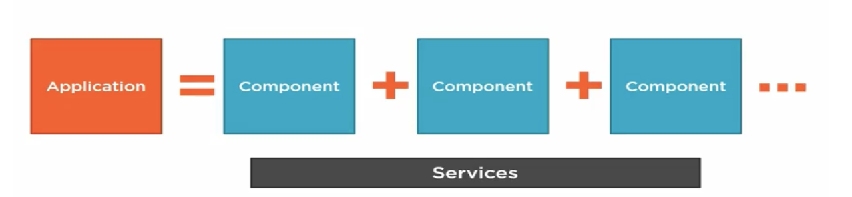
A Basic Angular 2 Application
An application is consists of a set of components, and some services, each component is comprised of a template, Classes and metadata.
Notes:
Angular Application is consists of set of components & some services .An Angular module, whether a root or feature, is a class with an @NgModule decorator.

Slide 12
A Basic Angular 2 Application- Module
Angular apps are modular and Angular has its own modularity system called Angular modules or NgModules.
Every Angular app has at least one Angular module class, the root module, conventionally named AppModule
An Angular module, whether a root or feature, is a class with an @NgModule decorator
NgModule is a decorator function that takes a single metadata object whose properties describe the module.

Slide 13
A Basic Angular 2 Application-Module
Some important properties are
declarations - the view classes that belong to this module. Angular has three kinds of view classes: components, directives, and pipes.
exports - the subset of declarations that should be visible and usable in the component templates of other modules.
imports - other modules whose exported classes are needed by component templates declared in this module.
providers - creators of services that this module contributes to the global collection of services; they become accessible in all parts of the app.
bootstrap - the main application view, called the root component, that hosts all other app views. Only the root module should set this bootstrap property.

Slide 14
A Basic Angular 2 Application-Root Module
Every application has at least one Angular module, the root module that you bootstrap to launch the application.
import { NgModule } from '@angular/core';
import { BrowserModule } from '@angular/platform-browser';
import { AppComponent } from './app.component';
@NgModule({
imports: [ BrowserModule ],
declarations: [ AppComponent ],
bootstrap: [ AppComponent ]
})
export class AppModule { }
Notes:
The export of AppComponent is just to show how to export; it isn't actually necessary in this example. A root module has no reason to export anything because other components don't need to import the root module.
Launch an application by bootstrapping its root module. During development you're likely to bootstrap the AppModule in a main.ts file like this one.
After the import statements, you come to a class adorned with the @NgModule decorator
The @NgModule decorator identifies AppModule as an Angular module class (also called an NgModule class). @NgModule takes a metadata object that tells Angular how to compile and launch the application.
imports — the BrowserModule that this and every application needs to run in a browser.
declarations — the application's lone component, which is also ...
bootstrap — the root component that Angular creates and inserts into the index.html host web page.
Add instructor notes here.

Slide 15
A Basic Angular 2 Application-Root Module
Launch an application by bootstrapping its root module—main.ts .
Angular ships as a collection of JavaScript modules. We can think of them as library modules. Each Angular library name begins with the @angular prefix.
The application module needs material from within that BrowserModule. To access that material, add it to the @NgModule metadata imports like this.
imports: [ BrowserModule ]
import { platformBrowserDynamic } from '@angular/platform-browser-dynamic';
import { AppModule } from './app/app.module';
platformBrowserDynamic().bootstrapModule(AppModule);
Notes:
There are many ways to bootstrap an application. The variations depend upon how you want to compile the application and where you want to run it.
In the beginning, you will compile the application dynamically with the Just-in-Time (JIT) compiler and we run it in a browser.
The recommended place to bootstrap a JIT-compiled browser application is in a separate file in the src folder named src/main.ts
The bootstrapping process sets up the execution environment, digs the root AppComponent out of the module's bootstrap array, creates an instance of the component and inserts it within the element tag identified by the component's selector.
The AppComponent selector — here and in most documentation samples — is my-app so Angular looks for a <my-app> tag in the index.html
<my-app><!-- content managed by Angular --></my-app>

Slide 16
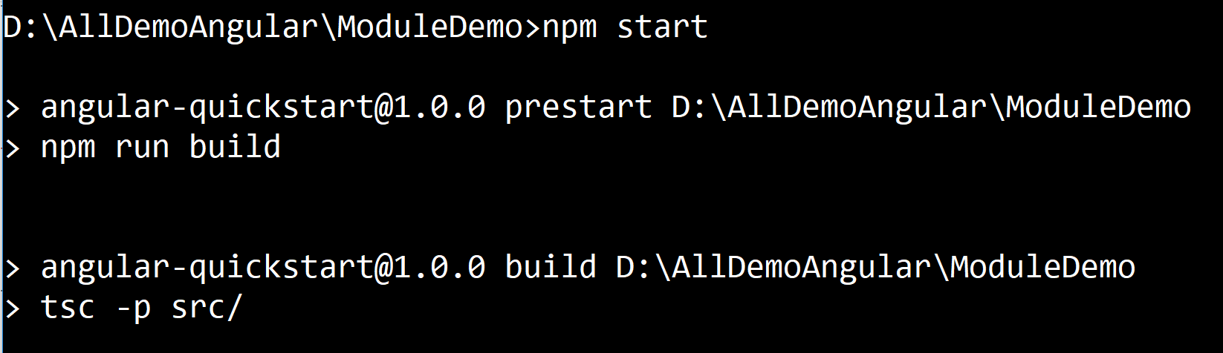
Working with Angular 2 with Eclipse
Download Eclipse with Angular2 plugin & typescript
https://www.eclipse.org/oxygen/
Steps to run & create Angular projects in Eclipse
Go to File -> New-> Project->Java & choose java project
Copy the angular-quickstart shared projects with node module
Open cmd promp,go till eclipse work space where putted Angular Project
Run command --→ npm start

Slide 17
Demo
ModuleDemo
Notes:
Add the notes here.
Add instructor notes here.

Slide 18
Summary
Angular2 is a framework for building client applications in HTML
The framework consists of several libraries, some of them core and some optional.
Angular apps are modular and Angular has its own modularity system called Angular modules or NgModules
Notes:
Add the notes here.
Add instructor notes here.

Slide 19
Review Question
Question 1
Option 1
Option 2
Option 3
Question 2
True/False
Question 3: Fill in the Blanks
Notes:
Add the notes here.
Add instructor notes here.

